Slide 1

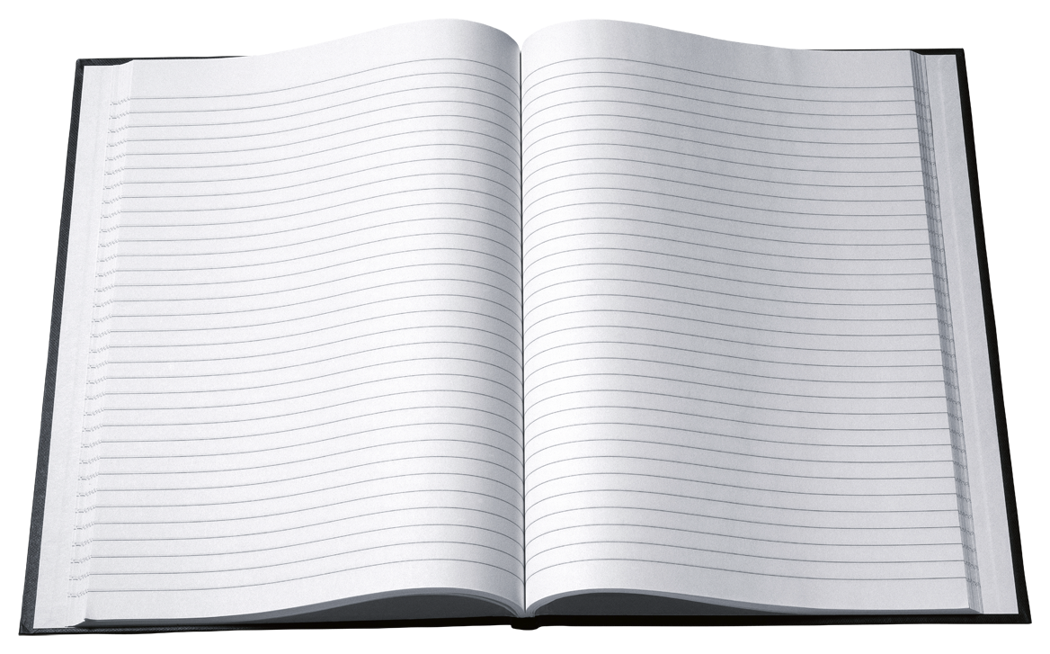
In the Reference Section!
What book should I look at?

Slide 2

The reference section in the library has different books for different kinds of information.
It is important to know what each of these books is for so that when you want information about something, you know where to look for it.

Slide 3
Follow this guide to learn about the different kinds of books in the reference section.
Click on the arrow at the bottom of each slide to go to the next slide.
Then you will play a game to see
what you have learned!
Next

Slide 4
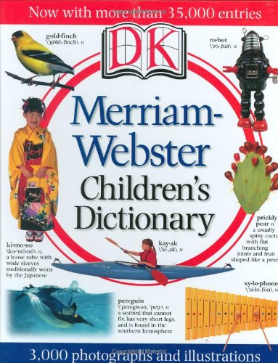
Dictionary
A dictionary is used
to find the meanings,
or definitions, of words.
Next
Image from amazon.com

Slide 5
Do you know what a beverage is? If you do not, look it up in the dictionary!
bev·er·age
Pronunciation: bev-(-)rij
Function: noun
: a liquid for drinking
From Merriam-Webster’s Student Dictionary
Next

Slide 6
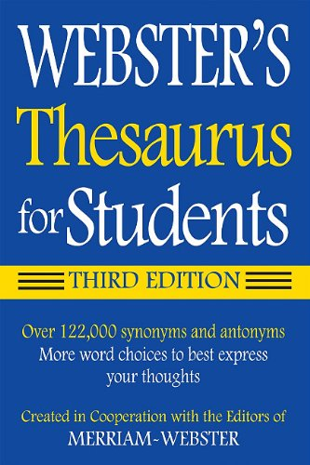
Thesaurus
A thesaurus is used to show you different words that mean the same thing. These words are called synonyms.
It can also show you words that mean the opposite of a word. These words are called antonyms.
Next
Image from amazon.com

Slide 7
If you want to know other words that mean the same thing as happy, look in the thesaurus!
sad adjective
Synonyms bad, blue, brokenhearted, cast down, crestfallen, dejected, depressed, despondent, disconsolate, doleful, down, downcast, downhearted, down in the mouth, droopy, forlorn, gloomy, glum, hangdog, heartbroken, heartsick, heartsore, heavyhearted, inconsolable, joyless, low, low-spirited, melancholic, melancholy, miserable, mournful, saddened, sorrowful, sorry, unhappy, woebegone, woeful, wretched
From Merriam-Webster Thesaurus
Next

Slide 8
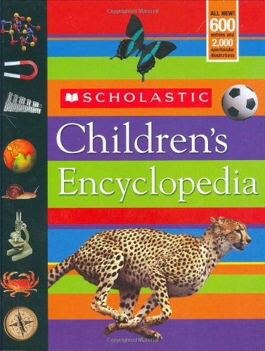
Encyclopedia
An encyclopedia has information about all kinds of different subjects.
It has so much information that it is divided into separate books called volumes. The volumes of an encyclopedia are in ABC order.
Next
Image from amazon.com

Slide 9
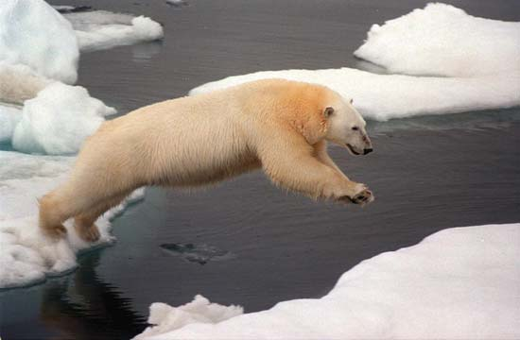
Do you want to know where polar bears live? Check out the encyclopedia!
Greenpeace—EPA/Corbis
From Encyclopaedia Britannica Kids
The polar bear is a burly white bear that lives in the lands surrounding the North Pole.
Next

Slide 10
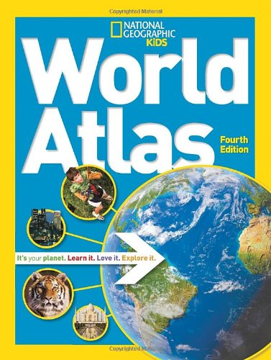
Atlas
An atlas is a book of maps. You can find an atlas with maps of Indiana, or the United States, or even the whole world.
Next
Image from amazon.com

Slide 11
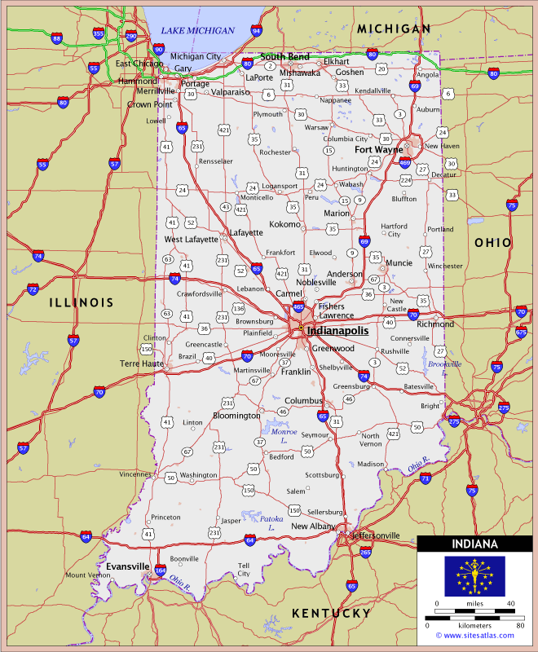
Would you like to help your parents plan a trip to Indianapolis? Use an atlas to find a map!
Next
Image from http://www.sitesatlas.com/Flash/USCan/static/INFH.htm

Slide 12

Almanac
An almanac is a book that is published every year that has information about how the planets and space affect Earth. It has a calendar of days, weeks, and months. It also gives facts about sunrises and sunsets, the seasons, and changes in tides.
Next
Image from amazon.com

Slide 13
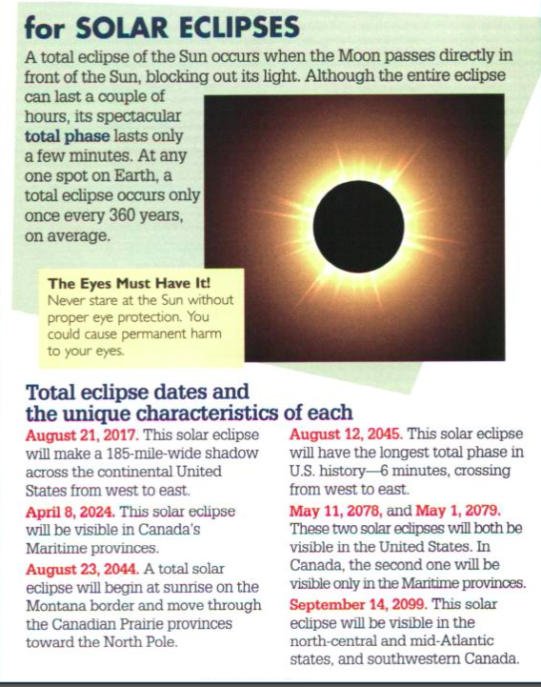
If you want to know when solar eclipses will happen in the future, you can look in an almanac!
Next
Image from The Old Farmer’s Almanac for Kids (http://www.amazon.com/The-Old-Farmers-Almanac-Kids/dp/1571983589)

Slide 14

Quick Review!
Dictionaries are for:
Definitions (meanings of words)
or
b. Synonyms (different words with the same meaning)
Click to see the answer
Image fom http://surveys.answers.com/article/17040419/Top-Survey-Question-Examples.html

Slide 15

The correct answer is a! You use dictionaries to find the meaning of words. The thesaurus is used to find synonyms.
Next
Image fom http://abovethelaw.com/2013/12/biglaws-most-underrated-firms-by-practice-area-2/thumbs-up/

Slide 16
Quick Review!
You can find information
about all different subjects
in:
Atlases
or
b. Encyclopedias
Click to see the answer

Slide 17
The correct answer is b! Encyclopedias have information about all different subjects. Atlases have maps.
Next

Slide 18
Quick Review!
In an almanac you can find:
Information about when
the sun will set each day
or
Information about weather
Click to see the answer

Slide 19
Trick question--the correct answer is both a and b! Almanacs can give you information about sunsets and the weather.
Next

Slide 20
Time to play a game!
Now it is your turn to figure out what book to look in to find information.
Read each question and decide which book Sally or Joe should look at to find the answer. Click on the correct answer.
If you click the wrong answer, try again!
Ready? Start the game!

Slide 21
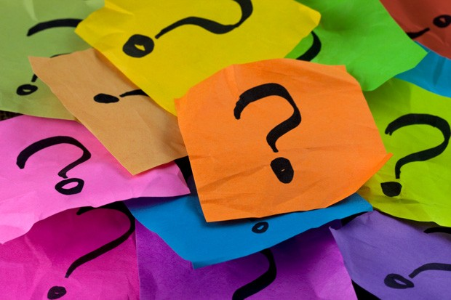
Question #1:
Sally wants to find a map of Africa so that
she can see where all of its
rivers are. What book
should she look at?
a.) A dictionary
b.) An atlas
Image from http://bouncykitty.wordpress.com/tag/work-interview/

Slide 22
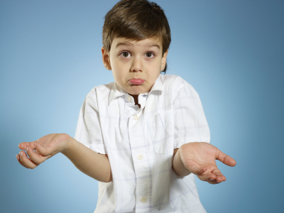
Oops!
Go back and try again!
Back to question
Image from http://ipcblog.org/wp-content/uploads/2011/09/iStock_000015180428XSmall.jpg-child-shrug.jpg

Slide 23
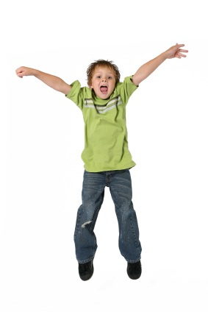
Great!
That’s correct!
Next question
Image from http://blog.zisboombah.com

Slide 24
Question #2:
Joe found the word “spatula” on
his homework, and he
wants to know what it
means. What book
should he look at?
a.) An almanac
b.) A dictionary

Slide 25
Oops!
Go back and try again!
Back to question

Slide 26
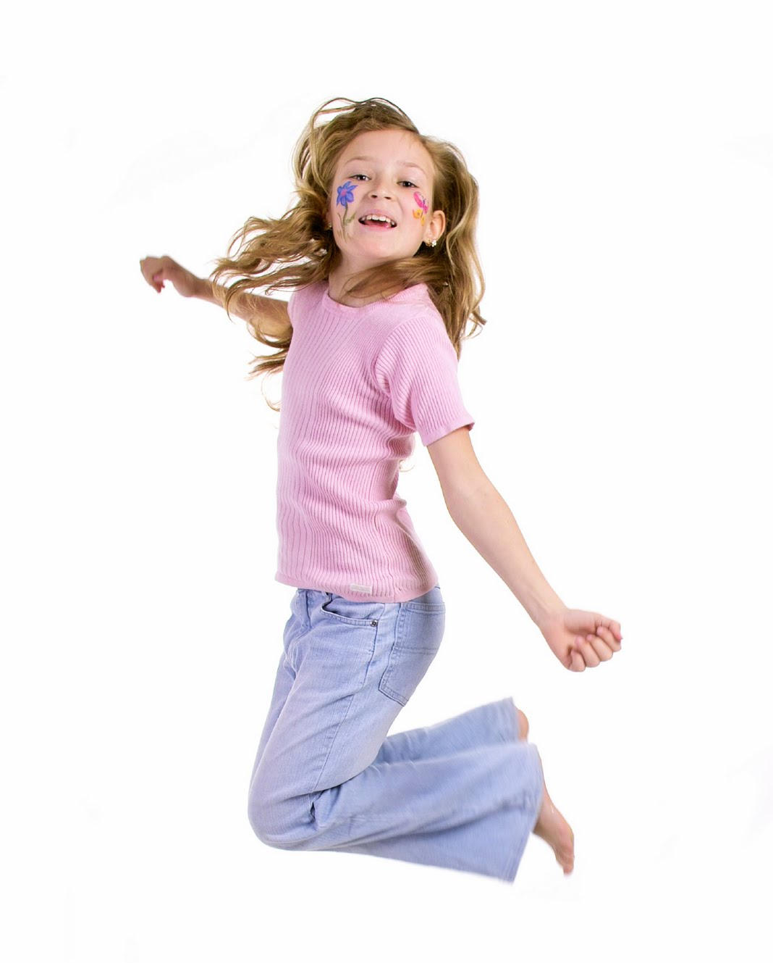
Wow!
That’s correct!
Next question
Image from http://activatefivesenses.com/wp-content/uploads/2013/04/iStock_000001755239Medium.jpg

Slide 27
Question #3:
Sally wants to find out what the
weather might be like this
summer. What book should
she look at?
a.) An almanac
b.) A thesaurus

Slide 28
Oops!
Go back and try again!
Back to question

Slide 29
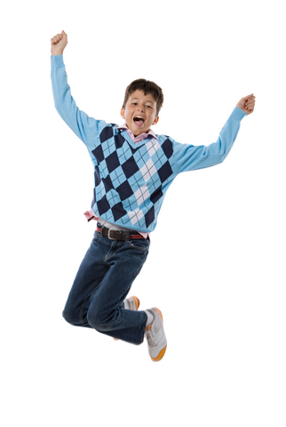
Awesome!
That’s correct!
Next question
Image from http://blog.zisboombah.com

Slide 30
Question #4:
Joe wants to do some research about bald
eagles. What book should
he look at?
a.) An encyclopedia
b.) A dictionary

Slide 31
Oops!
Go back and try again!
Back to question

Slide 32
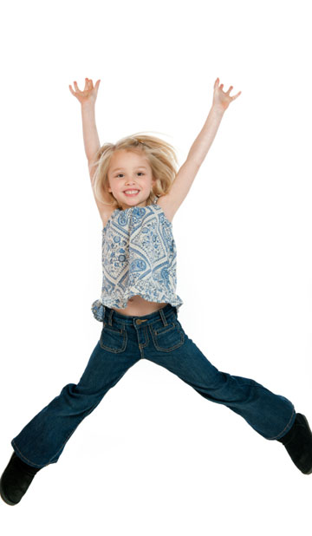
Wonderful!
That’s correct!
Next question
Image from http://www.sheknows.com/parenting/articles/966615/keeping-your-hyperactive-child-calm

Slide 33
Question #5:
Sally is writing a poem about trees, and she
wants to know some other
words that mean “tall”.
What book should she look
at?
a.) An encyclopedia
b.) A thesaurus

Slide 34
Oops!
Go back and try again!
Back to question

Slide 35
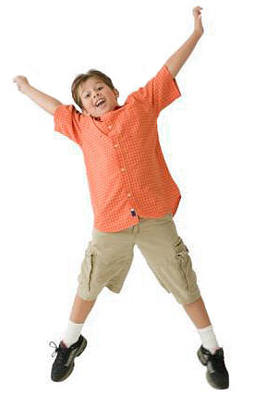
Fantastic!
That’s correct!
Next question
Image from http://www.liltotsdaycareonline.com

Slide 36
Question #6:
Joe needs to know the phases of the
moon. What book
should he look at?
a.) An almanac
b.) An atlas

Slide 37
Oops!
Go back and try again!
Back to question

Slide 38

Cool!
That’s correct!
Next question
Image from http://qualityjump.net

Slide 39
Question #7:
Sally needs to look up information for
the science fair about how
plants grow. What book
should she look at?
a.) An encyclopedia
b.) A thesaurus

Slide 40
Oops!
Go back and try again!
Back to question

Slide 41
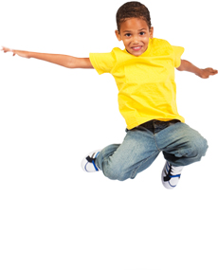
Nice!
That’s correct!
Next question
Image from http://kjrosefoundation.org/contact/

Slide 42
Question #8:
Joe wants to plan a trip with his family to
Disney World, and he needs
to find some maps. What
book should he look at?
a.) A dictionary
b.) An atlas

Slide 43
Oops!
Go back and try again!
Back to question

Slide 44
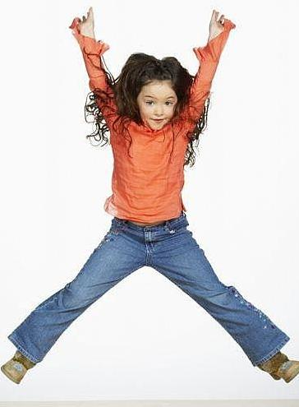
High five!
That’s correct!
Next question
Image from http://cuddlenread.blogspot.com/2011_01_30_archive.html

Slide 45
Question #9:
Sally saw the word “fragile” in her textbook,
and she wants to know what
it means. What book should
she look at?
a.) A dictionary
b.) An encyclopedia

Slide 46
Oops!
Go back and try again!
Back to question

Slide 47
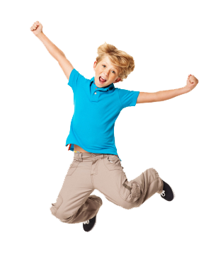
Good!
That’s correct!
Next question
Image from http://qualityjump.net

Slide 48
Question #10:
Joe is trying to describe his dog, but he
needs another word for
“soft”. What book should
he look at?
a.) An atlas
b.) A thesaurus

Slide 49
Oops!
Go back and try again!
Back to question

Slide 50
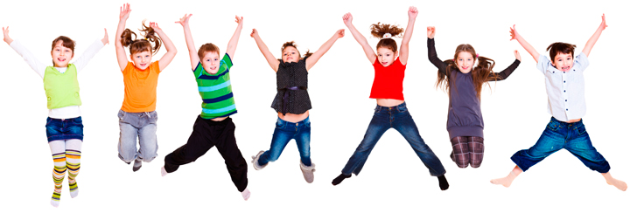
Correct!
Great job! You did it!
Next
Image from http://www.largo.com/egov/docs/131248687772.htm

Slide 51
Now you know all about
these different books
in the reference
section. The next time
you are at the library, remember these five kinds of books. The information you need just might be in one of them!
You finished!

