Slide 1
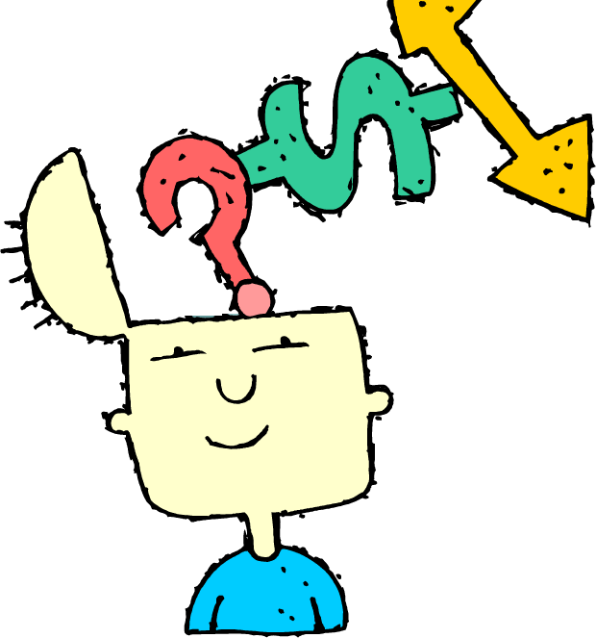
Preferences: Sensing Learners
Characteristics
Practical
Oriented toward facts and procedures (sights, sounds, sensations).
They like solving problems based on facts.
They don’t like surprises.
They are slower at translating symbols like words, so may time out on tests.
concrete
1 – Preferences 2 – Perceiving 3 – Processing 4 - Perspective
• Sensing learners • Visual learners • Active learners • Sequential learners
• Intuitive learners • Verbal learners • Reflective learners • Global learners
• Kinesthetic learners

Slide 2
Preferences: Intuitive Learners
Characteristics
Conceptual
Innovative
Oriented toward theories and meanings (possibilities, insights, hunches).
They like innovation, variety, creativity, and playing with ideas. They are impatient with details and make careless mistakes.
abstract
1 – Preferences 2 – Perceiving 3 – Processing 4 - Perspective
• Sensing learners • Visual learners • Active learners • Sequential learners
• Intuitive learners • Verbal learners • Reflective learners • Global learners
• Kinesthetic learners

Slide 3
Perceiving: Visual Learners
Characteristics
Prefer visual representations of presented material (pictures, timelines, diagrams, flow charts, films, demonstrations).
They tend to forget what people say, but remember visual demonstrations.
see
1 – Preferences 2 – Perceiving 3 – Processing 4 - Perspective
• Sensing learners • Visual learners • Active learners • Sequential learners
• Intuitive learners • Verbal learners • Reflective learners • Global learners
• Kinesthetic learners

Slide 4
Perceiving: Verbal Learners
Characteristics
Prefer written and spoken explanations (readings, lectures, discussions).
They prefer a verbal explanation and get a lot out of discussions.
read
1 – Preferences 2 – Perceiving 3 – Processing 4 - Perspective
• Sensing learners • Visual learners • Active learners • Sequential learners
• Intuitive learners • Verbal learners • Reflective learners • Global learners
• Kinesthetic learners

Slide 5
Perceiving: Kinesthetic Learners
Characteristics
Hands-on demonstrations
Movement
Organizing physical objects
do
1 – Preferences 2 – Perceiving 3 – Processing 4 - Perspective
• Sensing learners • Visual learners • Active learners • Sequential learners
• Intuitive learners • Verbal learners • Reflective learners • Global learners
• Kinesthetic learners

Slide 6
Processing: Active Learners
Characteristics
Learn by trying things out, working with others, testing out ideas, explaining to others (physical engagement or discussion).
They do poorly in lecture situations where they simply listen and aren’t asked to “do”.
They do well in groups. Ask them to evaluate ideas, carry out experiments, and find workable solutions.
They are organizers and decision-makers.
experimenter
1 – Preferences 2 – Perceiving 3 – Processing 4 - Perspective
• Sensing learners • Visual learners • Active learners • Sequential learners
• Intuitive learners • Verbal learners • Reflective learners • Global learners
• Kinesthetic learners

Slide 7
Processing: Reflective Learners
Characteristics
Learn by thinking things through, working alone (through interpersonal thought and quiet activities, watch & listen).
They do poorly in lecture situations where they simply listen and aren’t given time to “think” .
They do best by themselves. Ask them to define problems and propose solutions.
They are modelers and thinkers.
observer
1 – Preferences 2 – Perceiving 3 – Processing 4 - Perspective
• Sensing learners • Visual learners • Active learners • Sequential learners
• Intuitive learners • Verbal learners • Reflective learners • Global learners
• Kinesthetic learners

Slide 8
Perceptive: Sequential Learners
Characteristics
Linear, orderly, learn in small incremental steps (continual chunks of information, step-by-step progression).
They follow sequential content learning along with way. They can work with ideas they only understand superficially.
They are good at convergent thinking and analysis.
1 2 3 4 5 6
the trees
1 – Preferences 2 – Perceiving 3 – Processing 4 - Perspective
• Sensing learners • Visual learners • Active learners • Sequential learners
• Intuitive learners • Verbal learners • Reflective learners • Global learners
• Kinesthetic learners

Slide 9
Perspective: Global Learners
Characteristics
Holistic, system thinkers, learn in large leap, context and relevance (large jumps, big picture, and “lightbulb” moments). They may be lost for a while and suddenly “get it.”
They may not be able to explain how they got to solutions, however they are great at seeing connections between disciplines.
They are good at divergent thinking and synthesis. They are great at seeing the big picture, but can become lost and frustrated when dealing with individual skills and facts.
the forest
1 – Preferences 2 – Perceiving 3 – Processing 4 - Perspective
• Sensing learners • Visual learners • Active learners • Sequential learners
• Intuitive learners • Verbal learners • Reflective learners • Global learners
• Kinesthetic learners

