Slide 1
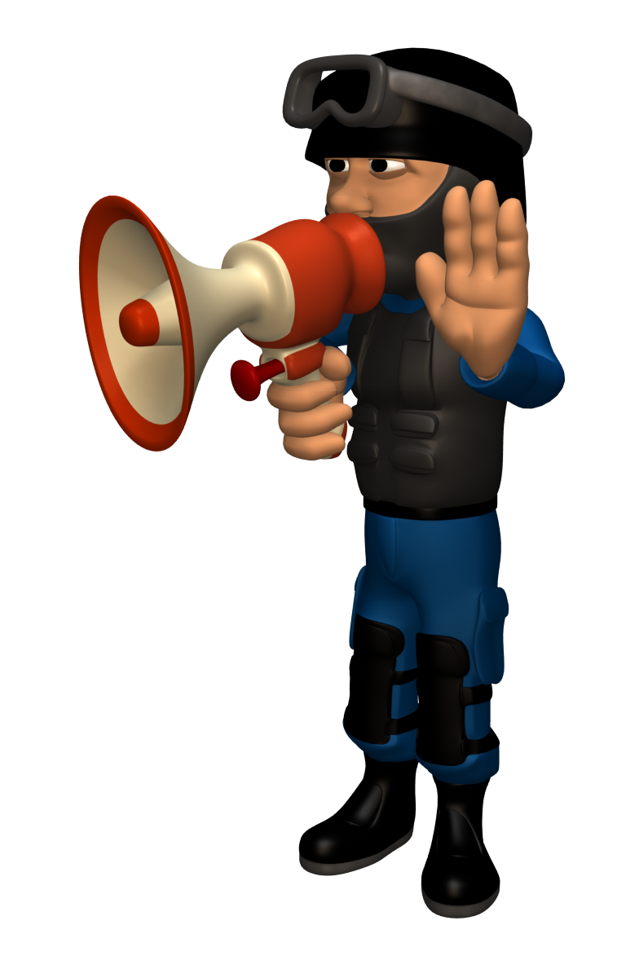
Join the SWAT Team
Become a lean, mean, research machine!
Just because it looks good doesn’t mean it IS good!
Notes:
Consider designing a set of criteria that fits the needs of your students. For instance, a media specialist in Ohio created the SWAT approach for his students.

Slide 2
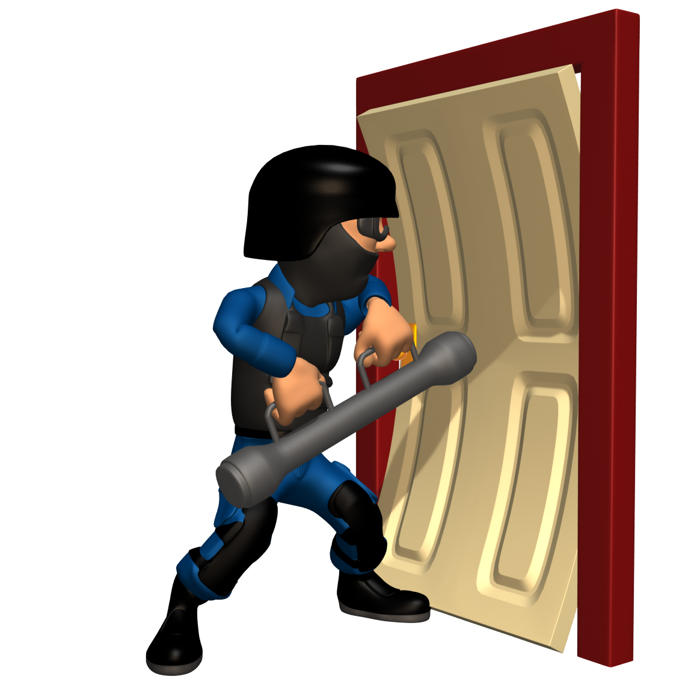
Site
Who
Audience
Timeliness
Join the SWAT Team!
Do website checks

Slide 3
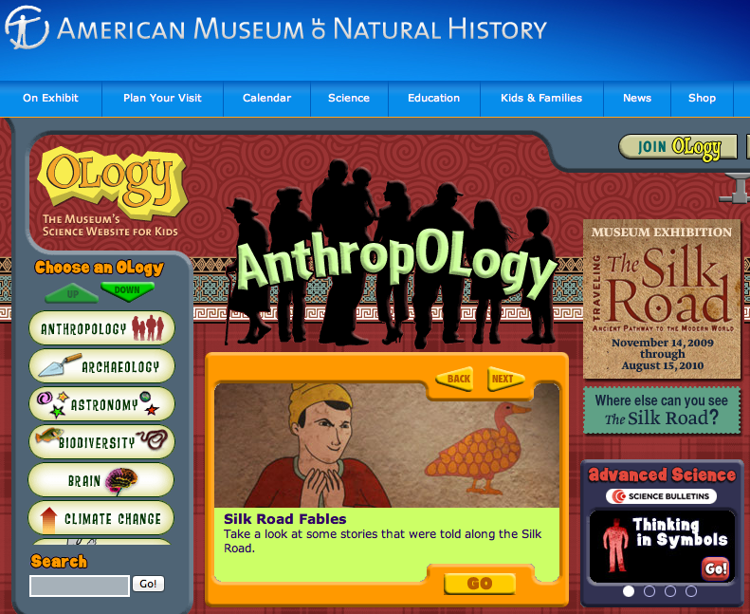
Site
Who
Audience
Timeliness
Look for govt & museum sites
What’s the motive?
Notes:
Examine the website itself. Look for government and museum sites. Think about the motives of nonprofit or company websites.

Slide 4
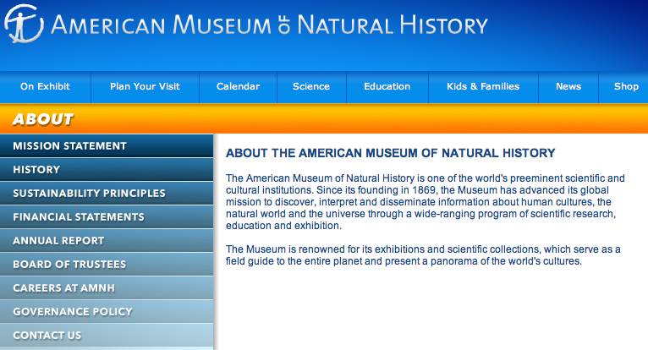
Site
Who
Audience
Timeliness
Who published the website?
About page?
Contact info?
Notes:
Think about who publishes the website. What is their expertise? How can they be contacted? Look for their ABOUT page.

Slide 5
Site
Who
Audience
Timeliness
Who is the site’s audience?
Is it for you?
Is it biased?
Notes:
Who is the audience for the website? Is it students or adults? Is it biased?

Slide 6
Site
Who
Audience
Timeliness
Is the information current?
Date info?
New enough?
Notes:
Look for information about the currency of the information. Is it new enough for your needs?

Slide 7
Site
Who
Audience
Timeliness
Before you enter…
Do a SWAT check!

Slide 8
Site
Who
Audience
Timeliness
What sites are allies of your research? Why?
What sites are enemies of your research? Why?

